Slide 1
Housing Opportunities
Made Easy (H.O.M.E.) Plan
Philadelphia H.O.M.E. Initiative
1

Slide 2
Plan Context & Core Principles
Philadelphia H.O.M.E. Initiative
Notes:
AB

Slide 3

H.O.M.E. Initiative: the Housing Plan for 30,000 Units
Mayor Parker’s Housing Opportunities Made Easy (H.O.M.E.) Plan recognizes housing is the key to ensuring our city is the most competitive, quality place for our people of today and tomorrow.
This plan, a key element of ensuring that there is economic opportunity for all, makes access to affordable, attainable, quality, safe, healthy, and resilient housing a top priority.
Notes:
AB

Slide 4



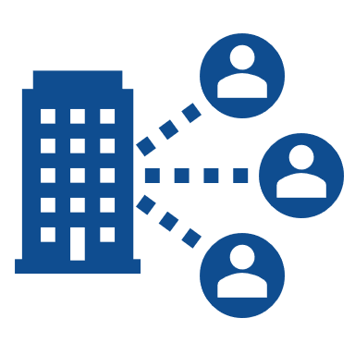



North Star Goals
Funds will be distributed across a multi-pronged approach to address Philadelphia’s housing challenges for renters and homeowners by increasing our city’s investment in seven core pillars, or North Stars:
Preserve our homes Philadelphia has an older housing stock. Make sure our homes stay livable, healthy, quality, and safe.
Make our homes more affordable All Philadelphians should be able to afford a quality home in a community that is rich with amenities and access to jobs.
Build more housing We need more housing at all income levels and in all neighborhoods. Let’s unlock the potential of our land to build more housing supply.
Make the City work better for the people Our government is responsive to you. Whether you’re a homeowner, renter, landlord, or developer, we must provide a high level of customer service.
Prevent housing instability and homelessness Nobody in Philadelphia should be homeless, or fear losing their home. We need to reduce housing instability and prevent homelessness.
Make our homes and communities resilient Philadelphia is investing in its infrastructure and housing to ensure that it is in good repair and resilient from disasters like storms and flooding.
Reduce blight and improve our communities Quality housing relies on strong communities. We need to redevelop our vacant lots and buildings, and invest in beautifying our blocks.
Notes:
AB

Slide 5
Plan Goals:
The goals of the plan will focus on:​
Total Investment: $2 billion over four years
Goal: Create and preserve 30,000 housing units across different income levels
Production
Preservation
Stabilization
Incentives
Work Better
Developing various housing types and options across every income level, in every neighborhood.
Addressing essential repairs and maintenance needs for an aging housing stock.
Focusing on housing stability and preventing homelessness through rental assistance and eviction diversion.
Promoting homeownership opportunities to foster thriving communities and generational wealth.
Providing a high level of customer service to all residents.​
Notes:
AB

Slide 6
Housing Goals and Targets
Philadelphia H.O.M.E. Initiative
Notes:
AB

Slide 7
Housing Goals & Targets
The H.O.M.E. Initiative goals were structured to meet ambitious, yet achievable housing targets based on the comprehensive collection and analysis of data. These unit targets do not represent everything that will be produced and preserved in Philadelphia over the next four years—these are only the units that will count towards the H.O.M.E. Initiative goals.
Income Band* |  | Income** | Production |  | Preservation | Totals
 |  |  | Ownership | Rental | Total Preserved
Deeply Affordable | 0-30% | < $32,250 | - | 1,800 | 7,200 | 9,000
Affordable | 30-50% | $32,250-$53,750 | 1,400 | 2,500 | 7,900 | 11,800
Workforce Housing | 50-80% | $53,750-$85,950 | 2,100 | 2,900 | 1,200 | 6,200
Workforce Plus | 80-120% | $85,950-$129,000 | 1,100 | 1,400 | 200 | 2,700
Market Rate | > 120% | >$129,000 | 150 | 150 | - | 300
Totals |  |  | 4,750 | 8,750 | 16,500 | 30,000
*Income band is determined by percentage Area Median Income (AMI).
** Household Income is a based on a household size of 3 people.
Notes:
AB

Slide 8
2025 Area Median Income Table
The AMI table below serves as a reference for the income limits outlined under income eligibility.
 | Philadelphia MSA AMI Table: 2025
 | AMI
Household Size | 30% | 40% | 50% | 60% | 65% | 80% | 100% | 120%
1 | $25,100 | $33,450 | $41,800 | $50,150 | $54,350 | $66,850 | $83,600 | $100,300
2 | $28,650 | $38,250 | $47,800 | $61,900 | $62,100 | $76,400 | $95,500 | $114,650
3 | $32,250 | $43,000 | $53,750 | $64,800 | $69,850 | $85,950 | $107,250 | $129,000
4 | $35,800 | $47,800 | $59,700 | $71,650 | $77,650 | $95,500 | $119,400 | $143,300
5 | $38,700 | $51,600 | $64,500 | $77,400 | $83,850 | $103,150 | $129,000 | $154,750
6 | $41,960 | $55,450 | $69,300 | $83,150 | $90,050 | $110,800 | $138,550 | $166,250
7 | $47,340 | $59,250 | $74,050 | $88,850 | $96,250 | $118,450 | $148,100 | $177,700
8 | $52,720 | $63,050 | $78,850 | $94,600 | $102,450 | $126,100 | $157,650 | $189,150
*The Philadelphia-Camden-Wilmington, PA-NJ-DE-MD MSA contains the following areas: New Castle County, DE; Cecil County, MD; Burlington County, NJ; Camden County, NJ; Gloucester County, NJ; Salem County, NJ; Bucks County, PA; Chester County, PA; Delaware County, PA; Montgomery County, PA; and Philadelphia County, PA.*
Notes:
AB

Slide 9
Housing Goal & Target Rationale
The H.O.M.E. Initiative goals and targets calculation were based on the following assumptions and rationale.
Philadelphia is short about 17,000 housing units in undersupplied areas across the city.
  The total number of new housing units required was estimated by identifying a normal vacancy rate that allows for movement in the housing market.
  Current vacancy rates in many areas are below this normal level.
  Based on several housing market indicators, used the 2012-2018 period as a baseline (generally, the housing market stabilized post-2010 crash and was not yet impacted by COVID)
Some locations have excess housing with many vacant units available for sale or rent, but the rents/prices of those units are not affordable to those who need housing.
Philadelphia has an estimated 22,000 homes requiring investment to maintain quality and livability, based on their age, value, code violations and/or below average (or worse) condition as assessed by the Office of Property Assessment.
The H.O.M.E. Initiative aims to create 13,500 new units and preserve 16,500 existing units, targeting roughly 78% of the needs for new housing and homes requiring preservation.
Notes:
AB

Slide 10
How is the City paying for the $2B H.O.M.E Initiative?
$800 million in bonds issued by the City of Philadelphia
Federal and State Funds: including Community Development Block Grant (CDBG) funds, Low Income Housing Tax Credits (LIHTC), HOME Investment Partnership, and more
Housing Trust Fund (HTF): Local funds supporting affordable housing programs
City General Fund: Allocated for land management, homelessness programs, and housing services
Leveraging Private Capital: Encouraging investment from financial institutions, developers, and philanthropy to expand impact
City Land & Assets: additional value from City land and assets contributing to housing production
Notes:
AB

Slide 11
Recommendations
Philadelphia H.O.M.E. Initiative

Slide 12




Recommendations Overview
This Plan seeks to achieve the housing targets and meet the North Stars through actions and initiatives within the four categories below.
1. Process | 2. Policy | 3. Programs | 4. Financing
Conduct an internal organizational assessment to identify strengths and improve housing program processes including technology, outreach and process Develop a detailed partnership plan to leverage local, state and federal resources through strong public private collaborations | Introduce zoning and tax code reforms to responsibly increase housing and incentivize new development and rehabilitation | Continue or Invest in and expand successful programs and Introduce new programs to promote financing housing production and preservation, and providing services and financing for homeowners, homebuyers, tenants, landlords, developers, and contractors. | The H.O.M.E Initiative will combine funding from federal (HUD), state and local (HTF, General Fund, Bond Proceeds) with private, philanthropic, and pensions investments to support affordable housing
Notes:
JL

Slide 13
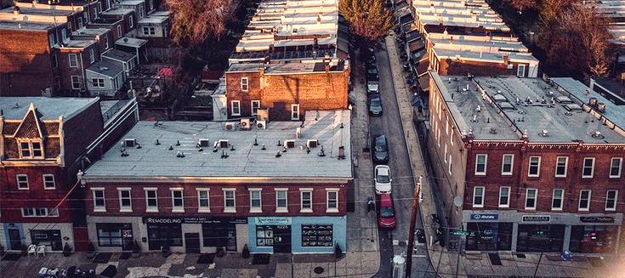
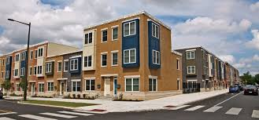
Program Recommendations
The most visible path to realize housing solutions lies in our public-facing housing programs. The programs managed by the City and its partners are directly involved in financing housing production and preservation and providing services and financing for homeowners, homebuyers, tenants, landlords, developers, and contractors.
This Plan includes a specific and targeted set of recommendations for:
Continue: Continue successful existing programs.
Invest and Expand: Scaling existing pilot programs to expand their impact.
Introduce: Standing up new programs based on successful leading practices.
This combination of program approaches, along with tangible housing targets, funding sources and amounts, identified partners, and key steps to implementation will be essential for the City to reach our North Star goals..
Notes:
JL

Slide 14
Programs and Initiatives funded through
H.O.M.E.
Preserving Existing Housing
Supporting Renters & Preventing Homelessness
Basic Systems Repair Program (BSRP+): Free repairs for critical home systems.
Restore, Repair, Renew (RRR): Low-interest home repair loans.
Tangled Title Program: Helps resolve homeownership disputes.
Eviction Diversion Program: Mediation and financial assistance to prevent evictions
Shallow Rent Program: Rental assistance for low-income tenants
Tenant-Based Rental Assistance: Expanding affordable rental options
Expanding Affordable Homeownership
Neighborhood Revitalization & Blight Reduction
Philly First Home: Down payment assistance for first-time homebuyers.
Turn the Key: New affordable housing units for working families.
ONE Philly Mortgage: Low-interest, no-PMI mortgage program.
Philadelphia Land Bank: Acquiring and redeveloping vacant properties.
Facade Improvement & Curbside Appeal Programs: Beautification efforts.
PHS LandCare Program: Transforming vacant lots into green spaces.

Slide 15


Existing Program Recommendations
Each of these recommendations will help Philadelphians attain affordable, quality, desirable housing in every neighborhood, at every income level.
Renter
Name | Recommendation
Programs
Shallow Rent Program Assistance, Tenant-based | Invest in and expand
Rent and Security Deposit Assistance (Fresh Start) | Continue
Eviction Diversion | Continue
Homeless Prevention | Continue
EDP Targeted Financial Assistance | Invest in and expand
Philadelphia Eviction Prevention Programs and Right to Counsel | Continue
Transitional Housing and Homeless Prevention | Continue
Permanent Housing and Supportive Services | Continue
Tenant-Based Rental Assistance and Rapid Rehousing | Continue
Homeowner
Name | Recommendation
Programs
Basic Systems Repair Program+ (BSRP) | Invest in and expand
Built to Last | Continue
Philly First Home | Invest in and expand
Turn the Key | Continue
Employer Assisted Housing | Continue
Restore, Repair, Renew (RRR) | Invest in and expand
Row Home Protection Program | Invest in and expand
Tangled Title Fund & Tangled Title | Invest in and expand
Foreclosure Prevention | Continue
Weatherization Assistance Program | Continue
CDBG-DR Program | Continue
Neighborhood Advisory Committees | Continue
Notes:
JL

Slide 16


Existing Program Recommendations
Each of these recommendations will help Philadelphians attain affordable, quality, desirable housing in every neighborhood, at every income level.
Landlord/Property Owner/Homeowner
Name | Recommendation
Programs
Rental Improvement Fund | Continue
Heater Hotline Program | Continue
Targeted Housing Preservation Program | Continue
Neighborhood and Infrastructure Improvement Program | Continue
Developer
Name | Recommendation
Programs
Workforce Development | Continue
Accelerator Fund | Invest in and expand
Affordable Housing Preservation Funds | Continue
Renter or Owner
Name | Recommendation
Programs
UESF Utility Grant | Continue
Adaptive Modification Program (AMP) | Invest in and expand
PHS LandCare Program | Continue
Notes:
JL

Slide 17
Process Optimization
Philadelphia H.O.M.E. Initiative
Notes:
JL

Slide 18
Accomplishments to Date – Legislation
Recommendation | Description
Development Impact Tax (DIT) | While not repealed in full, specified affordable housing projects are exempted from the DIT, effective June 13th with the signing of Bill 250212.
Parking Minimums in CMX-4 and CMX-5 | Bill 250524 eliminated parking minimums for multi-family housing projects in the commercial core.
Duplexes in Rowhome Neighborhoods (RTA-2) | Bill 250525 created a new zoning district for two-family rowhomes. The district still needs to be mapped.
Fifth Council District (VDO) | Bill 250432 removed zoning overlay restrictions increasing the minimum lot size to 1,440 SF and preventing developments from participating in two zoning bonus programs.
Turn the Key in the MIN Overlay | Bill 250291 exempted Turn the Key projects in the MIN Overlay from MIN requirements.
Technical Omnibus | Bill 250523 corrected and clarified various sections of the Zoning Code.

Slide 19
Accomplishments to Date - Process
Recommendation | Description
Short-term rental variances | Held a training with ZBA Board members about the impacts of AirBnBs and other short-term rentals on residential neighborhoods, with the goal of reducing the number of Visitor Accommodation variances approved by the ZBA.
Support for pro-se appellants at the ZBA | Launched a quarterly training for pro-se appellants to the ZBA to prevent continuances, decrease scheduling load, and provide shorter wait times.
ZBA Notice of Decisions | ZBA implemented process changes to issue notices within 2-weeks of zoning appeal decision, down from a high of 10 weeks.
Zoning History in Atlas | Zoning history is now visible in Atlas to help new owners of a property avoid creating non-conforming or illegal uses.
Affordable Housing Review in eCLIPSE | Adopted eCLIPSE modification that for permits associated with eligible affordable housing projects to be certified for prioritized L&I reviews and/or Development Impact Tax exemption.
Gap Financing and MIHB | Allow LIHTC projects utilizing City funding to opt into the Mixed Income Housing Bonus (MIHB) for added, by-right density.

Slide 20
Next Steps
Philadelphia H.O.M.E. Initiative
Notes:
JL

Slide 21
HOME Budget Process (1/3)
1
Annual Program Statement & Budget
Submission Requirements:
  Preliminary Submission: At least 60 days before the final submission, the Mayor must send a preliminary Annual Program Statement and Budget to each member of the Council.
  Final Submission: The Mayor must submit the final Annual Program Statement and Budget to the Council for approval by resolution before each fiscal year.
Contents of the Annual Program Statement and Budget:
  Program Descriptions: A detailed description of each program for which the proceeds are intended to be spent.
  Targeted AMI Percentages: The targeted percentages of Area Median Income (AMI) for each program.
  Council Districts: Identification of each Council District affected by each program.
  Property Actions: A list of any properties the Mayor will ask the Council to take action on, and the nature of the action requested.
Notes:
Accountability: Annual Program Statements required before spending, with Council approval. This is the stage we are in now

Slide 22
HOME Budget Process (2/3)
2
Project Review Team
Review and Authorization:
  Composition: The Review Team consists of two members appointed by the Mayor and two by the President of Council.
  Authority: The Review Team can authorize changes to the approved Annual Program Statement and Budget, including reallocation of program funds, provided the total budget does not change and the cumulative reallocation does not exceed 10%.
  Start-Up Expenditures: The Review Team can authorize up to $5 million in start-up expenditures before the first Annual Program Statement and Budget approval, provided the program allocations for the funds are identified.
Notes:
Oversight: Project Review Team (2 Mayor + 2 Council appointees) for budget modifications up to 10% Transparency: Quarterly reporting on expenditures, real estate transactions, and MBE/WBE participation

Slide 23
HOME Budget Process (3/3)
3
Reporting Requirements
The Mayor must submit quarterly reports to the Council summarizing:
  Actual or committed expenditures
  Real estate transactions
  Participation of Minority, Female, and Disabled Owned Disadvantaged Business Enterprises
  Steps taken to ensure homeowner beneficiaries were referred to resources for tangled title counseling
Non-Severability: The provisions of Section 2 are inseparable from the rest of the Ordinance. No proceeds can be spent unless all approvals are obtained
4

Slide 24
Key Challenges
There are not enough dollars to fully fund all programs to service the need
There are multiple concurrent priorities, making budgeting challenging
We need to ensure successful deployment of funds in Year One
With new programs and ramped up programs, cashflow projections are challenging
We need to operate existing programs while building the program design and delivery infrastructure for new ones
We need to ensure efficiency, effectiveness, quality, customer service, and enhance our systems for data collection and reporting while “building the plane”
Notes:
Key Challenges & Solutions
Capacity Building: Operating existing programs while scaling up new ones
Readiness Assessment: Prioritizing Year One funding for programs ready to deploy quickly
Infrastructure Development: Building delivery systems while maintaining quality and efficiency

Slide 25





Timeline and Next Steps
The timeline and next steps for H.O.M.E. Initiative process include the following items:
1
2
3
4
5
Draft Housing Plan
City Council Review
Finalize Recommendations
Plan Implementation and Monitoring
Evaluation and Assessment
Ongoing Public Engagement
Notes:
JL

Slide 26
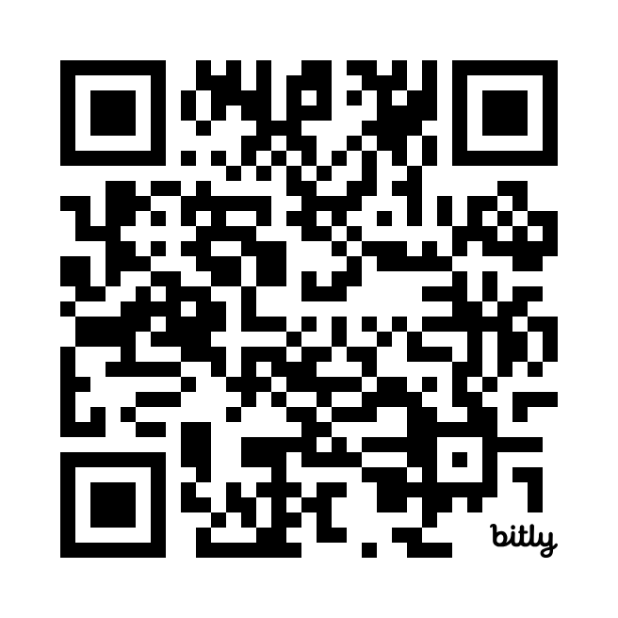
H.O.M.E. Initiative
The H.O.M.E. Initiative Report can be found here:
Questions or Comments:
Email us at
HOMEInitiative@phila.gov
Notes:
JL

Slide 27
Questions
Philadelphia H.O.M.E. Initiative

